Slide 1









STM32 Ecosystem workshop
ST LATAM team

Slide 2
Goal of this session
2
Get to know a little of ST’s 32-bit MCUs portfolio
To be able to create an application using STM32CubeMX
To be able to perform basic configuration, project processing and code writing within System Workbench For STM32 (SW4STM32) toolchain
To understand the concept of Hardware Abstraction Layer (HAL) and Low Layer (LL) libraries.
To be able to use some complementary debug tools
To be able to use the STM32 ODE pack libraries
To check the following applications examples: Bluetooth Low Energy/ MEMS / CLOUD BLUEMIX

Slide 3







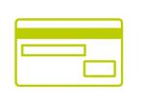

Microcontrollers ST has licensed all Cortex-M™ cores
Forget traditional 8/16/32-bit classifications and get
Seamless architecture across all applications
Every product optimized for ultra-low power and ease of use
Cortex-M0/M0+
Cortex-M3
Cortex-M4
Cortex-M7
MCU
16/32-bit applications
16/32-bit DSC applications
16/32-bit DSC applications
16/32-bit applications
Binary and tool compatible
www.st.com/stm32

Slide 4








Microcontrollers Today – STM32 portfolio overview
6
1
High-performance
STM32F401
STM32F411
STM32F405/415
STM32F407/417
STM32F427/437
STM32F429/439
STM32F2x5
STM32F2x7
STM32F746/756
STM32F030 Value line
STM32F0x1
STM32F0x2
STM32F0x8
STM32F100 Value line
STM32F101
STM32F102
STM32F103
STM32F105
/107
STM32F301
STM32F302
STM32F303
STM32F3x4
STM32F373
STM32F3x8
Mainstream
STM32L0x1
STM32L0x2
STM32L0x3
STM32L100 Value line
STM32L151/152
STM32L162
STM32L4x1
STM32L4x2
STM32L4x3
STM32L4x5
STM32L4x6
Ultra-low-power
Cortex-M0
Cortex-M0+
Cortex-M3
Cortex-M4
Cortex-M7
2

Slide 5
Workshop rules
3
For anyone that wants to redo this material, all the content and a lot of other usefull itens are available at my github page www.github.com/montanari9 The repository name is ARGENTINA, just download the USER_MATERIAL.zip file
All the exercises will be done by the trainer, but can be done by any participants with the tools.
In case of any trouble with the exercise it is possible to reuse from USER_MATERIAL:
Existing ready STM32CubeMX project for particular exercise (_STM32CubeMX projects folder)
Existing starting SW4STM32 project:
.\_SW4STM32 projects\STM32_Ecosystem_workshop_startups.zip
Source files modifications needed for each exercise: (Sources folder)
Already completed SW4STM32 project
.\_SW4STM32 projects\STM32_Ecosystem_workshop_solutions.zip

Slide 6
Training material overview
4
Folder name | File name | description
_STM32CubeMX projects | .ioc | Configured STM32CubeMX project files for each exercise
_Sources | sine.h | Sine buffer example for all F4_USART based exercises
 | template_src.c | Parts of the source code needed for each exercise.
_SW4STM32_projects | STM32_Ecosystem_workshop_startups.zip | Initial projects for each exercise.
 | STM32_Ecosystem_workshop_solutions.zip | Completed projects for each exercise
Documentation | *.pdf | Documentation referenced in the workshop (including board schematics)
Slides | *.pptx | Slides from the workshop

Slide 7
Agenda

Slide 8
Agenda
6
Creation and tuning of a simple project
System Workbench For STM32 (SW4STM32) toolchain
Complementary tools for debug (STMStudio and STLINK Utility)
Run the MEMS code ☺
Run the BLE Code with the MEMS and check the app!
Run the MEMS Cod e along with WIFI + MQTT to turn into a gateway application with IBM BlueMix and check the link!

Slide 9
Glossary

Slide 10
Explanation of the acronyms
8
ETM - Enhanced Trace Macrocell
ITM - Instrumentation Trace Macrocell
HAL Libraries – Hardware Abstraction Layer Libraries
LL Libraries – Low Layer Libraries
MSP/msp – microcontroller support package
PPP – marking of any peripheral – used to indicate name of the function, structure common for many peripherals
SVN – Subversion, Version Control System – one of the tool for sharing the software projects within working groups
SW4STM32 – System Workbench for STM32 – free toolchain for STM32 microcontrollers based on Eclipse
SWD - Single Wire Debug
SWIM – Single Wire Interface Module – programming/debugging interface in STM8 microcontrollers
SWO – Single Wire Output – one wire trace interface available in CortexM based microcontrollers (except CortexM0 and CortexM0+)
TRGO - Trigger Output - internal output signal of the timer used for synchronization with other peripherals (timers, DAC, ADC)

Slide 11
Installation of the tools and drivers

Slide 12
Checklist
10
Download, install SW4STM32 and upgrade it to the newest version
Download and install STM32CubeMX
Download and install STM32F4-Cube Libraries
Download and install STM32 STLink Utility
Download and install ST-Link V2.1 drivers
Download and install STMStudio
Download and install terminal application (i.e.Termite or HTerm)

Slide 13
Installation of SW4STM32
System Workbench For STM32

Slide 14
Install SW4STM32 toolchain 1/2
installation from MS Windows
12
In order to download SW4STM32 toolchain you need to register on
www.openstm32.org website
After registration and logging, please either go to the web itself and:
Select „System Workbench for STM32” from left side menu (it is called SW4STM32 as well).
Select „Downloading the System Workbench for STM32” link from Table of Contents.
Download and run
install_sw4stm32_win_64bits-latest.exe for 64-bit or
install_sw4stm32_win_32bits-latest.exe for 32-bit MS Windows.
In our session we will use “installation from MS Windows” option only.

Slide 15
Install SW4STM32 toolchain 2/2
installation from MS Windows
13
Launch System Workbench for STM32 installer.
You will receive pop-up error message displayed in case proper JavaRE version is not
installed on your system. Click "Ok" to get redirected to the Oracle JAVA website.
Warning : The architecture version for System Workbench for STM32 MUST follow your Java architecture version. SW4STM32 64-bits will only work with JavaRE 7 (and newer) 64-bits etc.
The first page describes the product features. Get familiar, click “Next” to continue.
Read and accept the license agreement to continue installation. Click “Next” to continue.
Choose installation path (default: C:\Ac6\SystemWorkbench). Click “Next” to continue.
NOTE: Avoid paths with white spaces included like "C:\Program Files\...".
Follow the installation and, after “Finish” message is displayed, click “Quit” to exit installer.

Slide 16
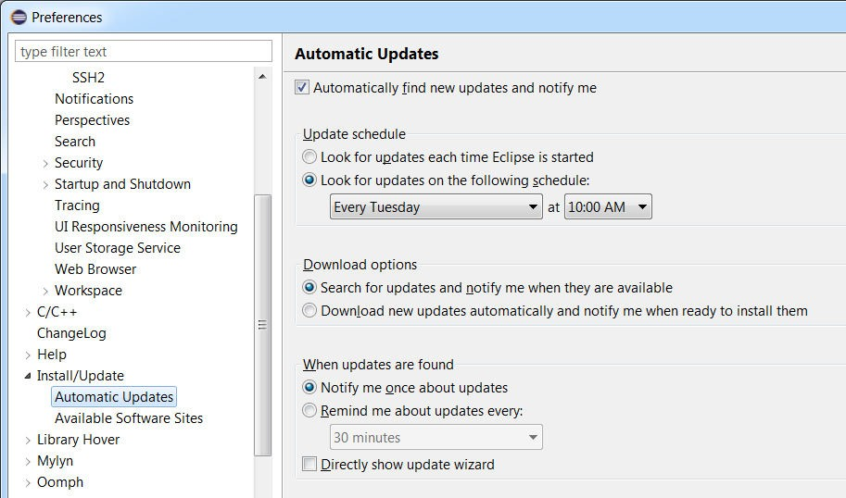
Update SW4STM32 to current version
configuration of automatic updates
In order to configure automatic finding new updates, please follow the procedure within SW4STM32:
8
Window -> Preferences
Install/Update –> Automatic Updates
Check “Automatically find new updates and notify me”
Configure Update schedule, download options and action to be done once updates are found accordingly

Slide 17



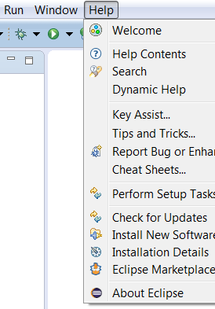
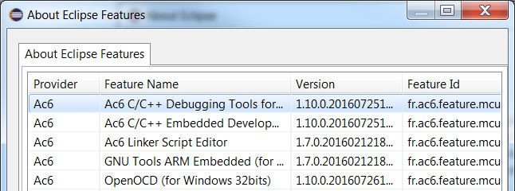
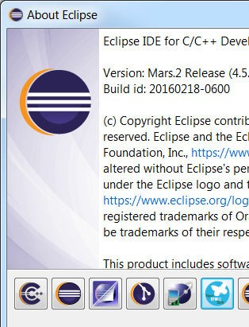

Checkpoint #1 verification of SW4STM32 installation
9
Help->About Eclipse

Slide 18

STM32CubeMX installation
Standalone version

Slide 19

STM32Cube Install
12
STM32CubeMX tool
http://www.st.com/stm32cube
The STM32CubeMX tool needs Java
Please check whether you have latest Java installed on your PC, for sure 32-bit and 64-bit version
You can either download STM32CubeF4 packages directly from STM32CubeMX or download them offline using the below links and install as local (“From loc…” button)
STM32CubeF4

Slide 20

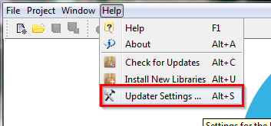

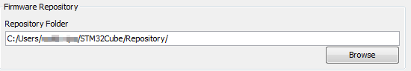
STM32Cube configuration 1/3
13
In case you download packages from web, you need to define place where they will be stored (repository)
MENU>Help>Updater Settings…
You will see current repository folder location
Default is C:/User/Acc_name/STM32Cube/Repository/
NOTE: In case your repository path contains diacritics, STM32CubeMX may fail to recognize them correctly. If this happens, change your repository path to contain raw Latin only (ex: C:/Repository)
You can either download STM32 packages manually and put them
into this folder or STM32CubeMX can do it for you if configured correctly

Slide 21

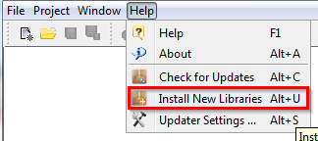
STM32Cube configuration 2/3
14
The comparison of the STM32CubeMX repository settings and folder structure
In case you want STM32CubeMX to download these files automatically
MENU>Help>Install New Libraries
Select required libraries
Force download with button “Install Now”
STM32CubeMX can download for you repository packages automatically

Slide 22

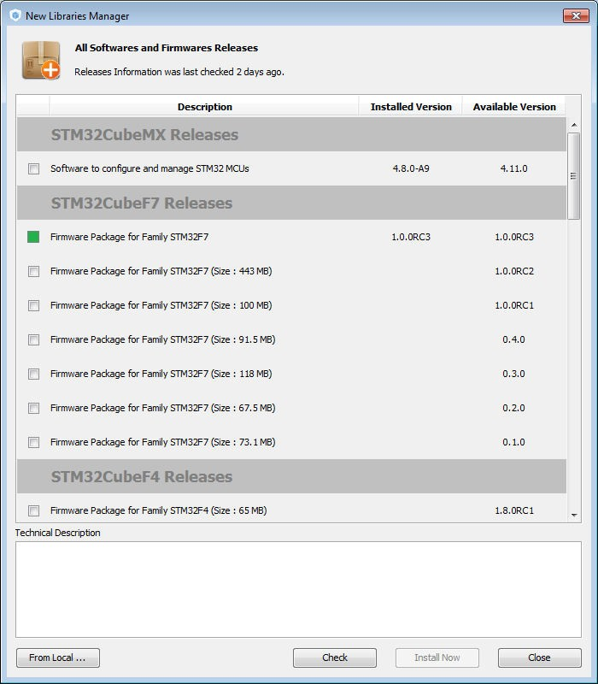


STM32Cube configuration 3/3
15
The comparison of the STM32CubeMX repository settings and folder structure
In case you want to install files manually
MENU>Help>Install New Libraries
Click “From Local…” button
Browse to select file to be installed
i.e. from provided USB stick package:
\HAL\STM32Cube_FW_F4_V1.13.0.zip

Slide 23
STM32CubeMX install
16
For code generation STM32CubeMX uses package from the Repository folder
Currently, STM32CubeMX can generate code for the following toolchains
Keil (free for F0/L0 families)
IAR
Atollic (free Lite version available)
System Workbench (SW4STM32 by AC6, free)
For debugging purposes, it is necessary to have ST-Link drivers installed.
Drivers are a part of ST-Link Utility package that can be found here
STSW-LINK004 ST-link Utility
To install drivers you will need Admin rights on your PC

Slide 24
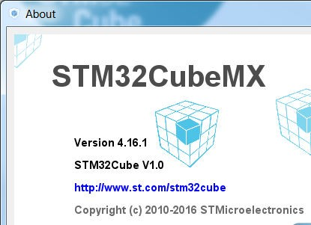



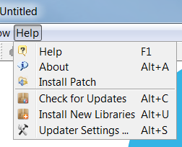

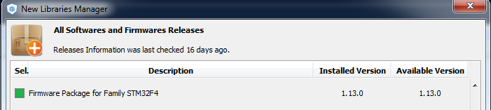



Checkpoint #2 verification of STM32CubeMX installation
17
Help->About
Help->Install New Libraries

Slide 25
Installation of STM32 ST-Link Utility

Slide 26
Download & Install STM32 ST-Link Utility
23
Drivers are available for Windows XP, Vista, 7, 8 & 10.
To download them use direct link:
http://www.st.com/content/st_com/en/products/embedded-software/development-tool-software/stsw-link004.html
Unzip the package and run executable (setup.exe)
Follow all default installation settings

Slide 27
Installation of ST-Link v2.1 drivers

Slide 28
Download & Install ST-Link/V2-1 drivers
25
Drivers are available for Windows XP, Vista, 7, 8 & 10.
To download them use direct link:
http://www.st.com/content/st_com/en/products/embedded-software/development-tool-software/stsw-link009.html
Unzip the package and run executable for x86 or AMD micro, depending on the platform you use
Follow all default installation settings

Slide 29
Installation of STMStudio application

Slide 30
Installing STMStudio
27
Ensure that the Java Run Time Environment (JRE) is installed and running on your machine.
JRE version 1.7 or more recent is required (JRE 7).
If installed JRE version is older than 1.7 or you miss it, please download the latest one from:
http://www.oracle.com/technetwork/java/javase/downloads/index.html.
Note that STM-STUDIO requires 32-bit JRE installed (even on 64-bit versions of Windows).
STMStudio can be found on www.st.com by putting stmstudio keyword into the search field
Once the JRE is installed or updated, run STMStudio_setup.exe.

Slide 31
2
Now it is a right time for some slides
We will present briefly what is STM32CubeMX and the structure of the Cube library

Slide 32
What it is STM32CubeMX ?

Slide 33
STM32CubeMX application
5
STM32CubeMx do allow to configure peripherals using GUI, generate project framework and peripheral initialization code.
STM32CubeMx do not allow to create algorithms using GUI and generate algorithms code yet – there is still some space for programmers left ;-)

Slide 34
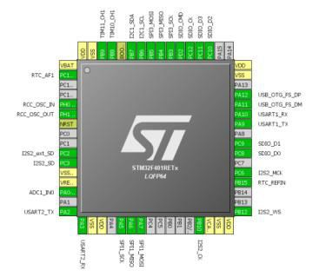
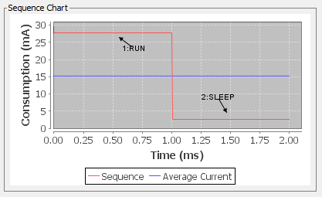
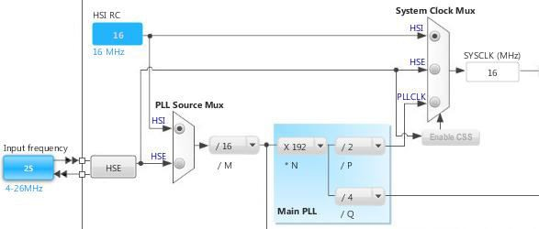
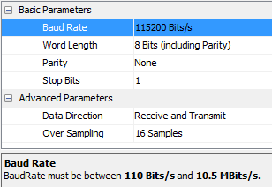





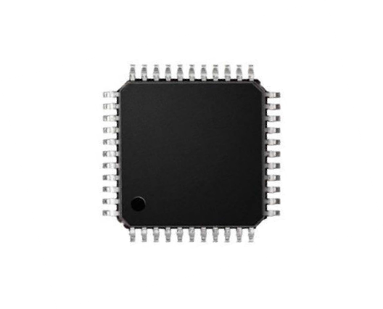


What it is STM32CubeMX ?
6
Pinout Wizard
Clock Tree Wizard
Peripherals & Middleware Wizard
Power Consumption Wizard
STM32CubeMX
Generates Initialization C Code based on user choices !

Slide 35







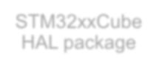














STM32Cube FW Package Organization
7
Can be found in STM32CubeMX repository
STM32xxCube HAL package
Documents
Drivers
Middleware
Projects
Utilities
Supporting files like fonts, pictures for graphic examples, …
Getting started with STM32F4Cube document

Slide 36


























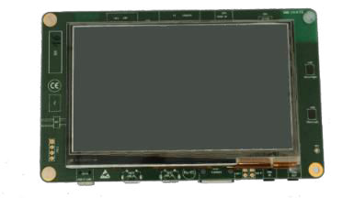

STM32Cube FW Package Drivers
8
Cube F4 HAL package
Documents
Drivers
Middleware
Projects
Utilities
Drivers
CMSIS
STM32Fxxx_HAL_Driver
BSP
Functions using HAL drivers to communicate with other components present on EVAL/Discovery boards
Register definitions for Core, startup files, ARM cortex libraries
HAL drivers for each periphery in STM32

Slide 37





































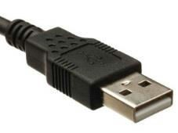
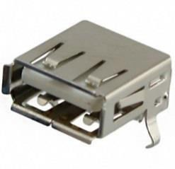



STM32Cube FW Package Middleware
9
Cube F4 HAL package
Documents
Drivers
Middleware
Projects
Utilities
Advanced set of libraries
Developed/Owned by ST
Middleware
Third Party libraries
ST
Third Party
STemWin
STM32_Audio
FatFS
FreeRTOS
STM32_USB_Device_Library
STM32_USB_Host_Library
LibJPEG
LwIP
PolarSSL

Slide 38


















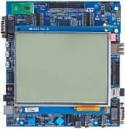




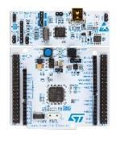






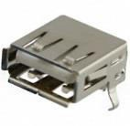
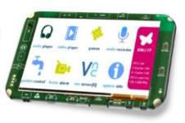
STM32Cube FW Package Projects
10
Cube F4 HAL package
Documents
Drivers
Middleware
Projects
Utilities
Complete projects for STM32 boards
STM32Nucleo, Discovery kits, Eval Boards
Projects
STM32F-Discovery
….
Templates
Examples
Applications
Demonstrations
Empty project only with startup file prepared for modification
Simple examples for STM32 Peripheries (GPIO, USART, …)
Advanced examples using Middleware (USB virtual com port)
Demonstration project combining multiple Middleware together

Slide 39
Preparation of the hardware

Slide 40
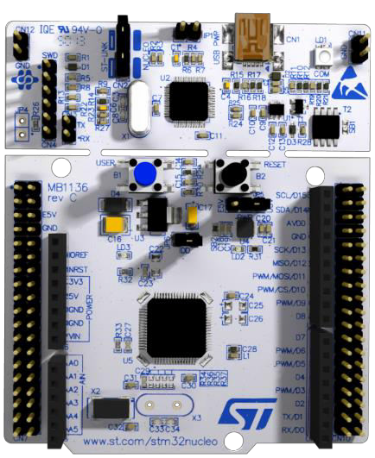
What we would need ?
12
NUCLEO-F401RE board
STLink v2.1
User Button on PC13
Reset
LD2 on PA5
Mini-USB cable
PC with preinstalled software (STM32CubeMX, SW4STM32, STLinkv2.1 drivers)

Slide 41
13
Now it is a right time for some software activity
Our first task is to create LED blinking application – just to check whether all the software packs and drivers are installed correctly and whether the hardware is ready for more challenging job

Slide 42
Goal of this part
14
To practice a little bit with STM32CubeMX by:
MCU selection
Play a bit with clock configuration for STM32F4 device
Create a skeleton of simple LED blinking application
Have some fun!

Slide 43
Creating the ‘F4_Blinky’ example in STM32CubeMX

Slide 44
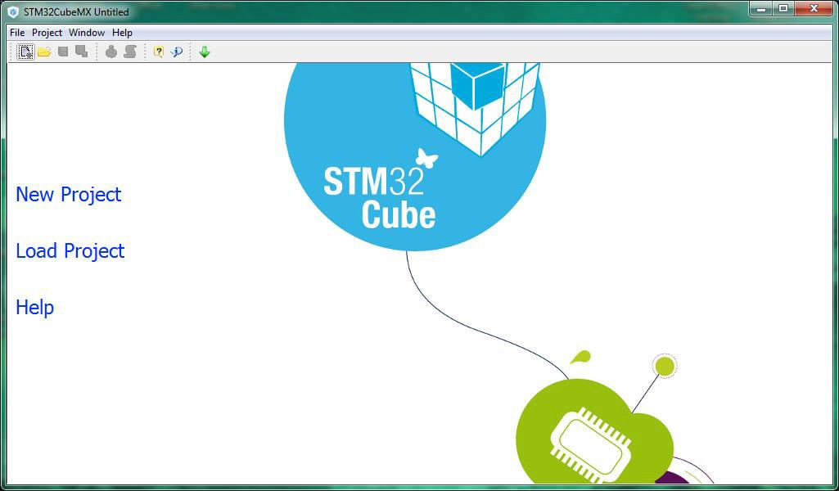
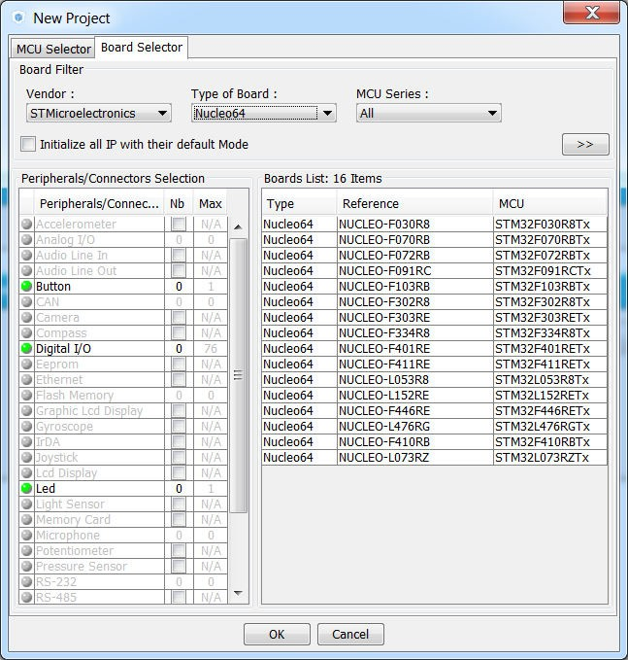
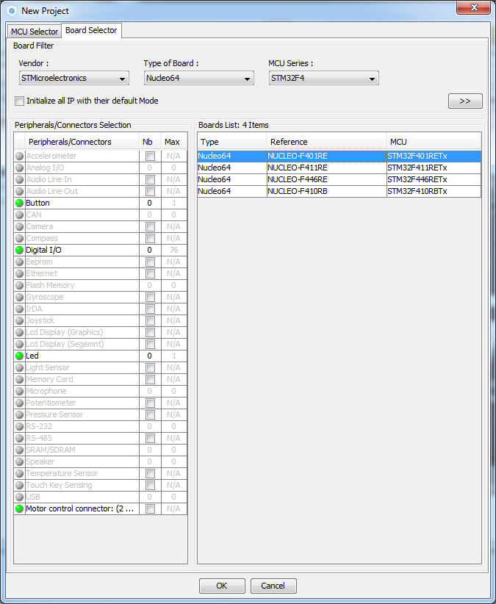
Creating a New Project
16
1. From the STM32Cube Home Page or Menu → File
select New Project
1
2. There are 3 ways to create a New Project
2
By STM32 Series and Product Line
By Peripheral Mix
By Board
3. For this example we will use NUCLEO–F401RE
Select the Board Selector Tab from the top left
Select Type of Board to be Nucleo64
Select STM32L4 in MCU Series
Select the NUCLEO–F401RE from the list on the right
Click ‘OK’ to continue

Slide 45
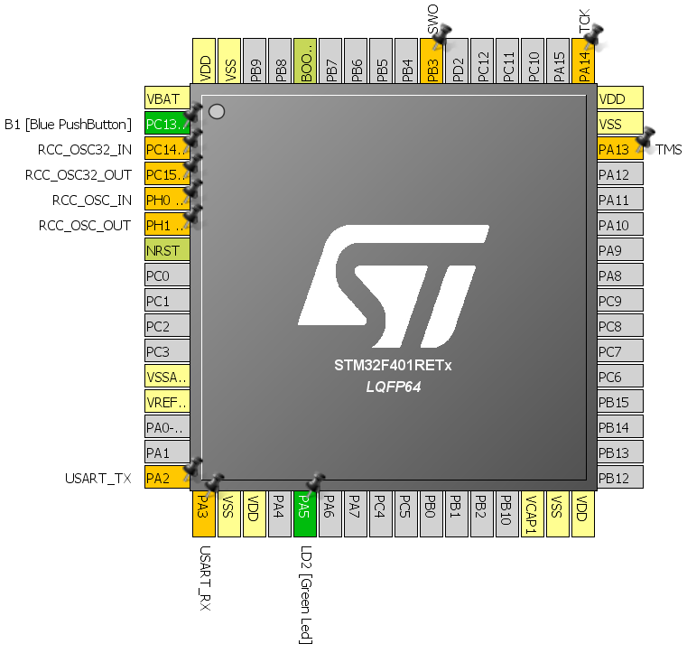
Peripheral and Pin Configuration
17
You will be presented with the pinout of the NUCLEO–F401R#
The debug pins, Push Button and LED are already highlighted in green, to say they are connected to the hardware on the board.
System Pins are highlighted in yellow/yellow-grey
Optional Hardware, like crystals and USART are highlighted in orange. This means there are PCB connections but not necessarily any hardware connected by default.
For the “F4_Blinky” example all relevant peripherals are
already connected, so no modifications are needed.

Slide 46
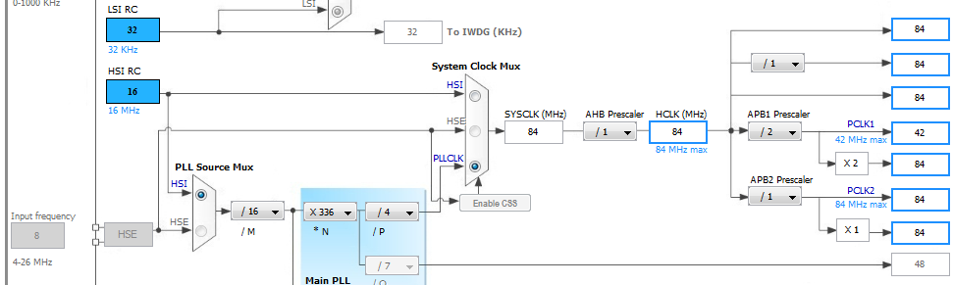
Clock Configuration
18
Task: Configure clock system to use internal oscillator with PLL @84MHz
1
1. Select ‘Clock Configuration’ tab
Select HSI in PLL Source Mux (HSI – High Speed Internal clock)
Select PLLCLK in the System Clock Mux
Set HCLK to 84 and press ENTER – application will propose PLL configuration to match this
requirement
4
2
3

Slide 47
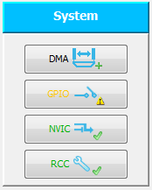
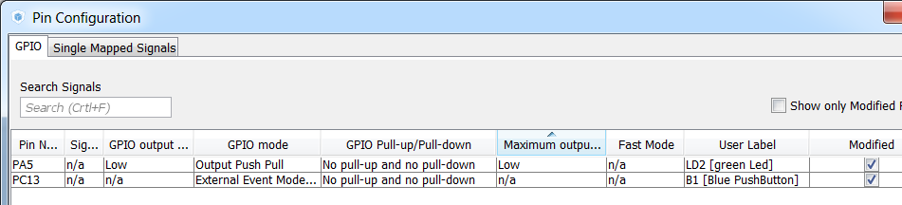
Peripheral Configuration
19
Select ‘Configuration’ tab
In this section peripherals with no physical pins or middleware can be added to the project
For the ‘F4_Blinky’ example no additional configuration is required as LED is already
configured in GPIO link as Output Push-Pull.

Slide 48
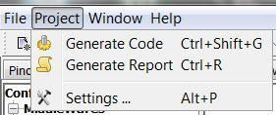
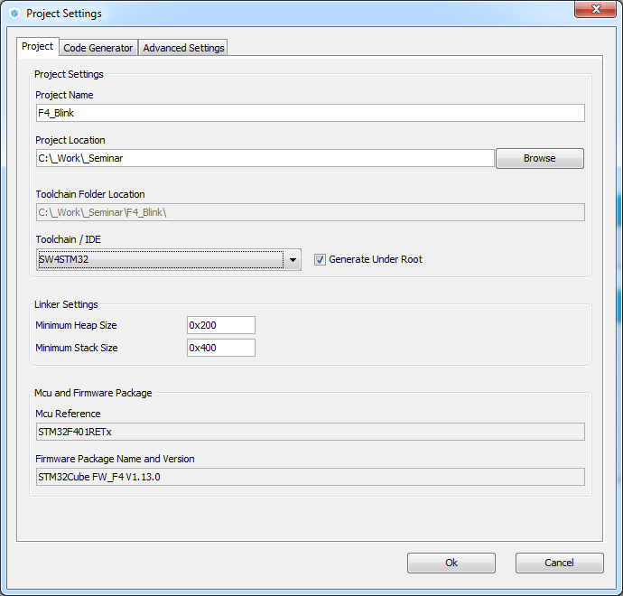
Configure the code generator 1/2
20
Open project setings:
Menu → Project → Settings
Under Project tab:
Give the project a name and location (i.e. F4_Blinky)
We strongly recommend to place this folder on the root of ‘C:’ as some C-compilers show issues when the build path contains too many characters
Select the toolchain to be SW4STM32
For better understanding let’s review code generation options (Code Generation tab) first

Slide 49
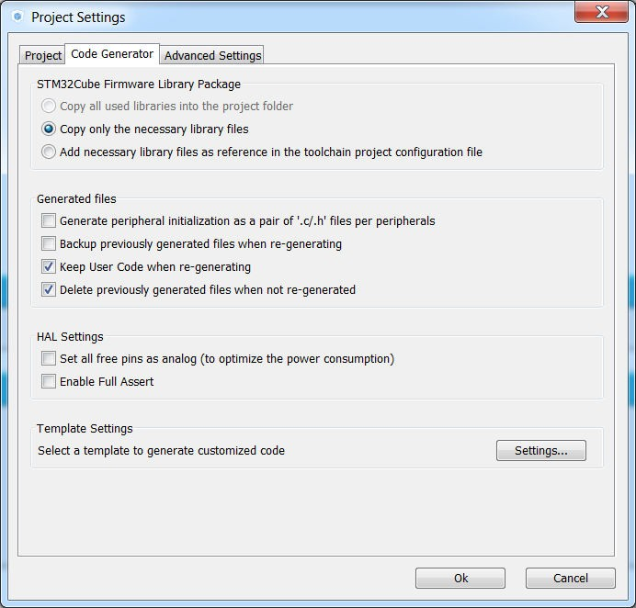
Configure the code generator 2/2
21
Code generator options
Copy either the full library or only the necessary files or just link the files from the common repository
Place all peripherals initialization in the stm32fxx_hal_msp.c file or one file per peripheral
Keep user code or overwrite it (refers to code placed between user code comment sections)
Delete or keep files that are not used anymore
Set unused pins as analog to keep consumption low (if SWD/JTAG is not selected in pinout, this option will disable it)
Enable full assert in project, this helps to discover incorrect HAL function parameter used in user code

Slide 50
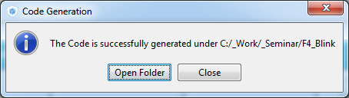
Code generation
22
Once we have configured the code generator, we can generate code for selected toolchain.
There are 3 ways to do it, namely:
Clicking icon
Pressing Ctrl+Shift+G keys combination
Selecting Project→Generate Code option from menu
When prompted, click ‘Close’ (we will import this project from SW4STM32 IDE).

Slide 51

2
After successful code generation by STM32CubeMX this is the right time to import it into SW4STM32 toolchain for further processing

Slide 52
Handling the project in SW4STM32

Slide 53
Our goals for this session
5
Handling the projects generated by STM32CubeMX in SW4STM32
Import project generated by STM32CubeMX
Tune sources to run selected peripherals in desired algorithm
Build project
Configure debug session
Run debug session
Debug perspective
Watching the variables and registers content
Handling errors

Slide 54
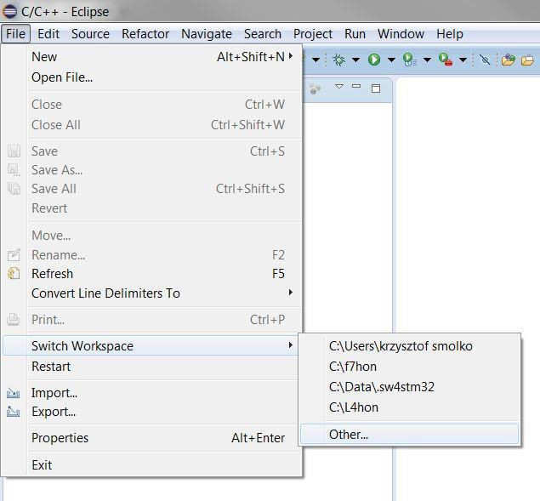
Create a new workspace - SW4STM32
6
Start Workspace launcher if not done automatically by Eclipse.

Slide 55
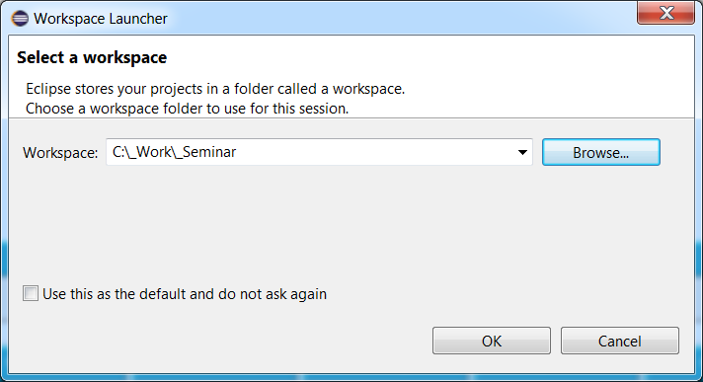
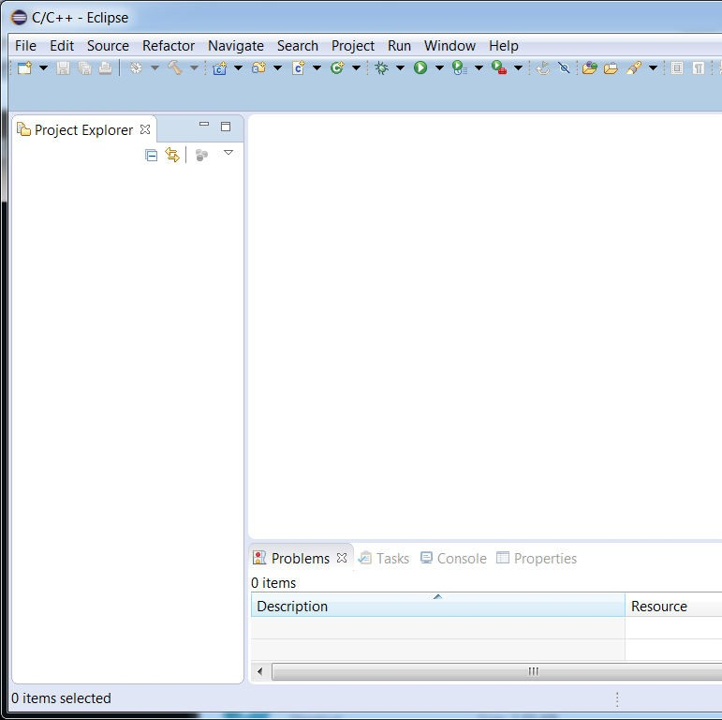
Create a new workspace
7
Create new workspace in the desired location – but not in the same folder where
the project which will be imported is located (it must be one level above the project)
An empty workspace will be generated

Slide 56
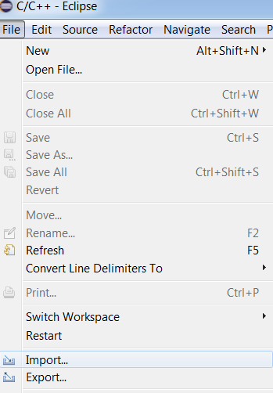
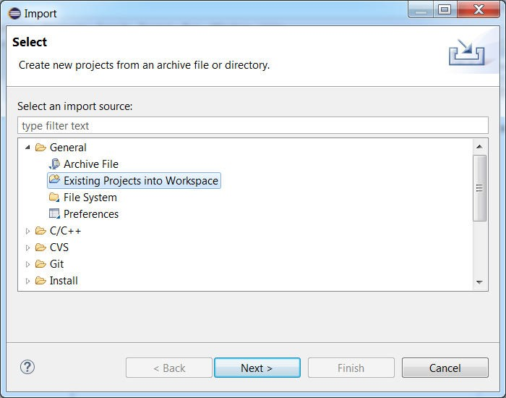
Import the project into the workspace 1/3
Import “F4_Blinky” project into empty workspace following below steps:
8
IMPORT project into workspace
This is possible to import multiple projects into a single workspace

Slide 57
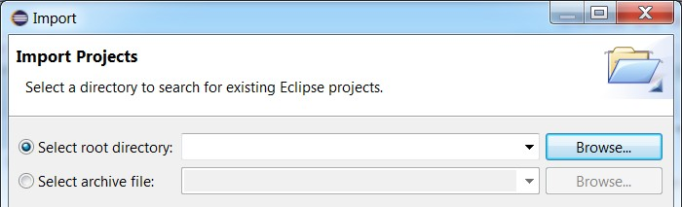
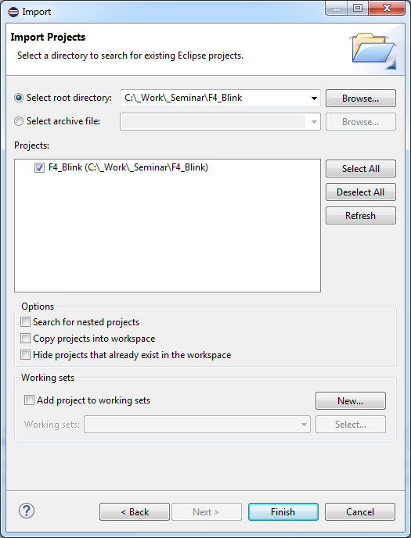
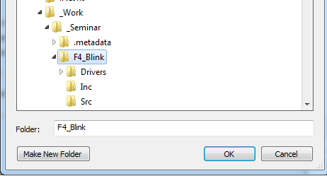
Import the project into the workspace 2/3
9
In this example F4_Blinky project will be processed.
1
3
Select project location
(as configured in STM32CubeMX –
Step2)
2
4

Slide 58
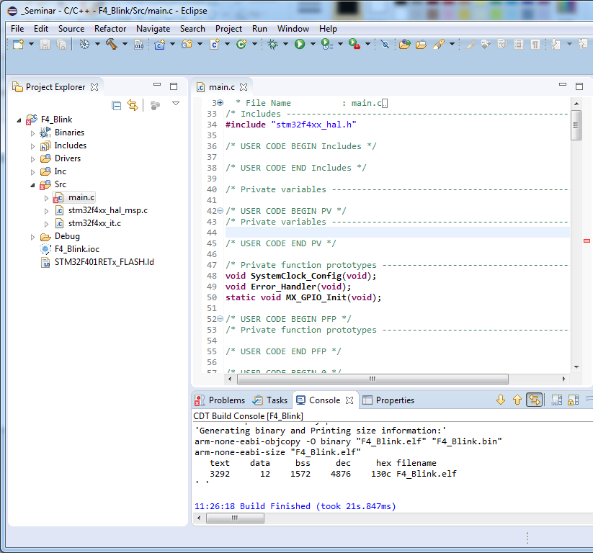


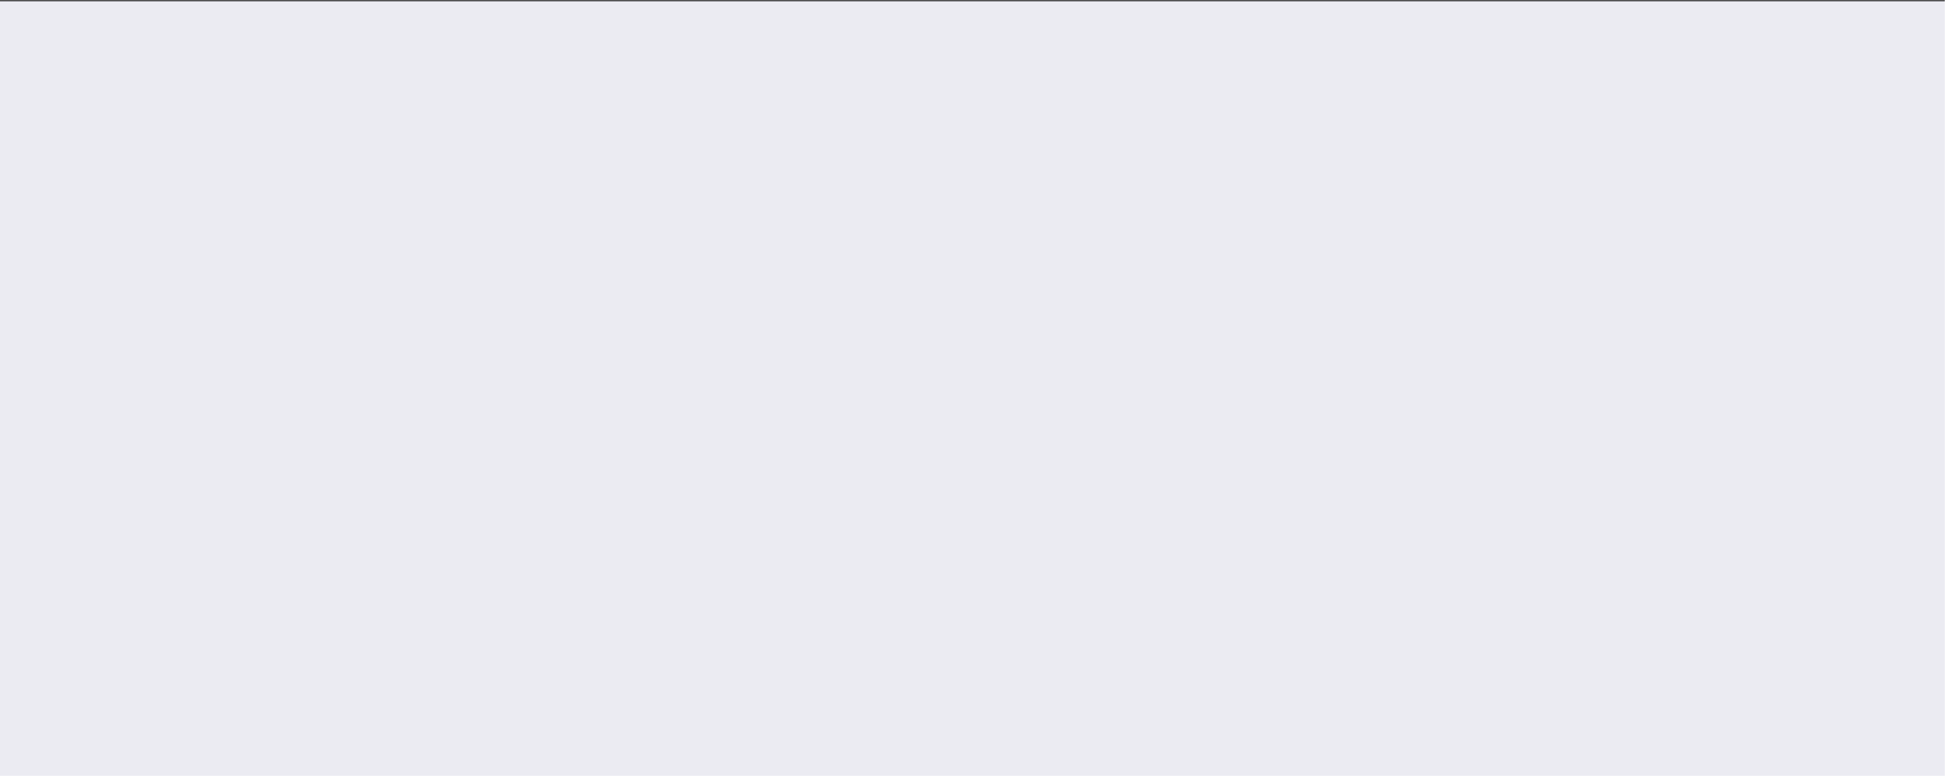
Import the project into the workspace 3/3
10
Once project is included into the workspace, its folder structure becomes visible in Project Explorer
Places dedicated for user code are marked by
/* USER CODE … BEGIN*/
and
/* USER CODE … END*/
comment lines.
These places are protected from being removed during code re-generation by STM32CubeMX.
This is possible to define another user code places in .c
source files but not possible in .h header files.
Warnings and errors after build the project

Slide 59
11
STM32CubeMX generated project is only a skeleton which should be filled with some code from our side
To make green LED (connected to properly configured PA5 pin) we should continuously invoke GPIO toggle function with the proper delay to make blink visible

Slide 60



Modifying the code – Blink LED
12
Tasks (within while(1) loop in main.c):
Add GPIO pin toggle function for PA5 pin. Which function we can use here?
?
Add 500ms delay between each change of the GPIO pin state. Which function we can use here?
?
Hints:
All HAL function begins with HAL_PPP_ prefix (PPP – short name of the peripheral, i.e. GPIO)
Please try to use Content Assistant (Ctrl+SPACE) in Eclipse

Slide 61

Modifying the code – Blink LED
13
Solutions (within while(1) loop in main.c):
Add GPIO pin toggle function for PA5 pin. Which function we can use here?
HAL_GPIO_TogglePin();
Add 500ms delay between each change of the GPIO pin state. Which function we can use here?
HAL_Delay();
/* Infinite loop */
/* USER CODE BEGIN WHILE */
while (1)
{
/* USER CODE
END WHILE */
/* USER CODE BEGIN 3 */ HAL_GPIO_TogglePin(GPIOA, GPIO_PIN_5);
HAL_Delay(500);
}
/* USER CODE END 3 */

Slide 62



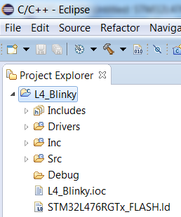
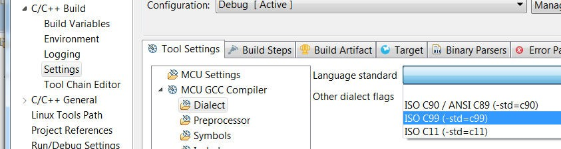

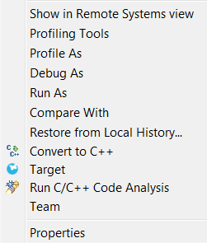




Useful project settings in SW4STM32
configuring C dialect and parallel build
14
Project->Properties
C/C++ Build->Settings->Tools Settings tab->MCU GCC Compiler->Dialect
1. Configure C standard to C99 to avoid possible compilation errors
1
C/C++ Build->Behavior tab
2. Check Enable parallel build to make use of your machine potential and to shorten compilation time
2

Slide 63


Compiler optimization levels
8
Optimization levels are accessible within project properties (right click the project name)
Within project Properties select:
C/C++ Build -> Settings ->Tool Settings->MCU GCC Compiler->Optimization From
From drop-down menu select required optimization level
Click Apply->OK buttons when completed

Slide 64



Issue with missing _IRQn
9
During code generation with “Generate
Under Root” option selected, all header files for a complete family are added to the project causing an error with unresolved parameter (too many sources with the same definition) → this is necessary to change indexer settings.
Project Properties->C/C++ General->Indexer
check this option
uncheck this option

Slide 65


Building the project in SW4STM32
15
To build the project press Ctrl+B or click Make All icon
In case of multiple compilation
errors, re-run Indexing of the project
After proper build there are information about code/data space usage in Console window displayed

Slide 66

Configure the debug session in SW4STM32
16
for single project in the workspace
Before running debug session this is necessary to configure it for current project
In case there is a single project in the workspace this is enough to click the “bug” icon and:
1
Select “Ac6 STM32 C/C++ Application”
line and click ‘OK’
In case the project was generated on existing/defined board (like NUCLEO- LF401RE in our example) debug will run automatically
Next step would be to run the debug session
(see the next slide)

Slide 67



Configure the debug session in SW4STM32
for multiple projects in the workspace
17
Before debugging current project for the first time, this is necessary to configure its debug session
Select Debug Configuration
All project parameters should
be filled-in automatically
1
option
3
Double click (or use right mouse button
2
to select) to create a new debug configuration for the current project

Slide 68

Debug session perspective watching the variables
20
This is possible to monitor CPU registers, peripherals registers and variables during debug session, but we need to pause the code execution (no live view is possible for the time being).
To add variable to be monitored - highlight it, press right mouse button and select “Add Watch Expression”. It will appear in Expressions tab then.
Values which has changed from previous project pause will be presented on yellow background
Watched variables
Values changed from previous application pause

Slide 69

Debug session perspective watching the registers content
21
This is possible to monitor CPU registers, peripherals registers and variables during debug session, but we need to pause the code execution (no live view is possible for the time being).
To add peripheral register to watch - click right mouse button and select “Activate”. Peripheral icon and its registers names will be highlighted in green and will contain “caught” values on next debug pause.
Values which has changed from previous project pause will be highlighted in red.
Peripherals
Core registers
registers
Non-watched peripheral
Value changed from previous application pause
Watched peripheral

Slide 70

Handling the debug session SW4STM32
22
1 2
3
4
5
6
7
Skip all breakpoints
Run/resume
Suspend
Terminate debug session
Disconnect from the target
Step into
Step Over
Step Return
windows configuration in debug perspective

Slide 71
How would I do that with another toolchain and kit???

Slide 72


STM32F072 Discovery
Integrated ST-Link/V2-1 (for programming and debugging)
4 LEDs
Gyroscope
2 push buttons
Touch Sense Slider

Slide 73
STM32F072 Discovery
NFC / ACP connector
USB Device Connector
Direct access to all MCU I/Os

Slide 74

Configure GPIO for LED toggling
Create project in CubeMX
Menu > File > New Project
Select Board> Discovery > F0 > STM32F072-DISCO
Notice the GPIO pins assigned to the LEDs

Slide 75
Configure GPIO for LED toggling
Here we can re-use the same code, just changing the GPIO ☺
/* Infinite loop */
/* USER CODE BEGIN WHILE */
while (1)
{
/* USER CODE
END WHILE */
/* USER CODE BEGIN 3 */ HAL_GPIO_TogglePin(GPIOC, GPIO_PIN_6);
HAL_Delay(200);
HAL_GPIO_TogglePin(GPIOC, GPIO_PIN_7);
HAL_Delay(200);
HAL_GPIO_TogglePin(GPIOC, GPIO_PIN_8);
HAL_Delay(200);
HAL_GPIO_TogglePin(GPIOC, GPIO_PIN_9);
HAL_Delay(200);
}
/* USER CODE END 3 */

Slide 76
2
Before adding a new code let’s go with some theory explaining the
Cube Library structure and what is generated by STM32CubeMX
Please don’t be mad at me, this will be quick ;)

Slide 77
Goal of this part
4
Understand the structure of the code generated by STM32CubeMX
Know the role of the library files
Know the role of the functions executed before main
Understand interrupt handling process

Slide 78
STM32CubeMX generated code

Slide 79




STM32CubeMX generated codecode structure, main operations after the reset
6
SystemInit(); main()
{
HAL_Init()
{
HAL_MspInit();
}
Located in: system_stm32f4xx.c
Called from: startup_stm32f4xx.s (reset vector before main())
STM32CubeMX
It performs the following operations:
Enables Floating Point Unit (FPU) inside the core
Resets the Clock Configuration to the default reset state
Disables all Interrupts
Configures Vector Table location and its offset
SystemClockConfig();
MX_PPP_Init()
{
HAL_PPP_Init()
{
It does NOT configure the clock system (as it was done in Standard Peripherals Library (SPL))
HAL_PPP_MspInit();
}
}
User
HAL_PPP_Action(); while(1);
}

Slide 80
STM32CubeMX generated code code structure, main operations after the reset
7
SystemInit(); main()
{
HAL_Init()
{
HAL_MspInit();
}
Located in: stm32f4xx_hal.c
Called from: main.c
STM32CubeMX
It performs the following operations:
Configures FLASH accelerator
Configures NVIC priority (group and sub-priorities split)
Configures SysTick for 1ms tick (based on HSI clock)
Initializes Low-level hardware selected in STM32CubeMX (call to HAL_MspInit() function)
SystemClockConfig();
MX_PPP_Init()
{
HAL_PPP_Init()
{
HAL_PPP_MspInit();
}
}
User
HAL_PPP_Action(); while(1);
}

Slide 81
STM32CubeMX generated code code structure, main operations after the reset
8
SystemInit(); main()
{
HAL_Init()
{
HAL_MspInit();
}
Located in: stm32f4xx_hal_msp.c
Called from: stm32f4xx_hal.c
STM32CubeMX
It performs the following operations:
Configures Interrupts Priorities
(for each peripheral selected in STM32CubeMX)
SystemClockConfig();
MX_PPP_Init()
{
HAL_PPP_Init()
{
HAL_PPP_MspInit();
}
}
User
HAL_PPP_Action(); while(1);
}

Slide 82
STM32CubeMX generated code code structure, main operations after the reset
9
SystemInit(); main()
{
HAL_Init()
{
HAL_MspInit();
}
Located in: main.c
Called from: main.c
STM32CubeMX
It performs the following operations:
Configures System & Buses clocks
(based on STM32CubeMX clock settings)
SystemClockConfig();
MX_PPP_Init()
{
HAL_PPP_Init()
{
HAL_PPP_MspInit();
}
}
User
HAL_PPP_Action(); while(1);
}

Slide 83
STM32CubeMX generated code code structure, main operations after the reset
10
SystemInit(); main()
{
HAL_Init()
{
HAL_MspInit();
}
Located in: main.c
Called from: main.c
STM32CubeMX
It performs the following operations:
Initializes PPP peripheral based on STM32CubeMX configuration
SystemClockConfig();
Uses structures and dedicated initialization functions type HAL_PPP_Init()
Within those functions this is possible to tune a peripheral configuration
MX_PPP_Init()
{
HAL_PPP_Init()
{
HAL_PPP_MspInit();
}
}
User
HAL_PPP_Action(); while(1);
}

Slide 84
STM32CubeMX generated code code structure, main operations after the reset
11
SystemInit(); main()
{
HAL_Init()
{
HAL_MspInit();
}
Located in: stm32f4xx_hal_PPP.c
Called from: main.c
STM32CubeMX
It performs the following operations:
Initializes the PPP peripherial mode (according to parameters specified in the PPP_InitTypeDef structure) and the associated handler
SystemClockConfig();
MX_PPP_Init()
{
HAL_PPP_Init()
{
HAL_PPP_MspInit();
}
}
User
HAL_PPP_Action(); while(1);
}

Slide 85
STM32CubeMX generated code code structure, main operations after the reset
12
SystemInit(); main()
{
HAL_Init()
{
HAL_MspInit();
}
Located in: stm32f4xx_hal_msp.c
Called from: stm32f4xx_hal_PPP.c
STM32CubeMX
It performs the following operations:
Configures Clocks related to PPP peripheral
Configures GPIO lines assigned to PPP peripheral
Configures DMA channel assigned to PPP peripheral (except source and destination address and number of the data to be transferred – this is done by HAL_PPP_Action() function)
Configures Interrupts selected for PPP peripheral
SystemClockConfig();
MX_PPP_Init()
{
HAL_PPP_Init()
{
HAL_PPP_MspInit();
}
}
User
HAL_PPP_Action(); while(1);
}

Slide 86


STM32CubeMX generated code peripherals initialization (DAC example)
13
HAL_DAC_Init() function details
All HAL_DAC_Init() functions
are calling the same function
void HAL_DAC_MspInit(DAC_HandleTypeDef* hdac)
{
GPIO_InitTypeDef GPIO_InitStruct;
if(hdac->Instance==DAC)
{
/* USER CODE BEGIN DAC_MspInit 0 */
HAL_DAC_MspInit()
HAL_DAC_Init() start
Handler instance parameter
is used to determine which
/* USER CODE END DAC_MspInit 0 */
/* Peripheral clock enable */
HAL_RCC_DAC_CLK_ENABLE();
DAC needs to be initialized
HAL_DAC_MspInit() start
/**DAC GPIO Configuration PA4 ------> DAC_OUT1
*/
GPIO_InitStruct.Pin = GPIO_PIN_4; GPIO_InitStruct.Mode = GPIO_MODE_ANALOG; GPIO_InitStruct.Pull = GPIO_NOPULL; HAL_GPIO_Init(GPIOA, &GPIO_InitStruct);
Initialize GPIO lines
GPIO and linked DMA initialization
selected in
STM32CubeMX
HAL_DAC_MspInit() end
Initialize DMA channel
/* Peripheral DMA init*/
selected in
hdma_dac_ch1.Instance = DMA1_Channel2; hdma_dac_ch1.Init.Request = DMA_REQUEST_9; hdma_dac_ch1.Init.Direction = DMA_MEMORY_TO_PERIPH; hdma_dac_ch1.Init.PeriphInc = DMA_PINC_DISABLE; hdma_dac_ch1.Init.MemInc = DMA_MINC_ENABLE;
hdma_dac_ch1.Init.PeriphDataAlignment = DMA_PDATAALIGN_HALFWORD; hdma_dac_ch1.Init.MemDataAlignment = DMA_MDATAALIGN_HALFWORD; hdma_dac_ch1.Init.Mode = DMA_CIRCULAR;
hdma_dac_ch1.Init.Priority = DMA_PRIORITY_LOW;
if (HAL_DMA_Init(&hdma_dac_ch1) != HAL_OK)
{
Error_Handler();
}
HAL_LINKDMA(hdac,DMA_Handle1,hdma_dac_ch1);
STM32CubeMX
HAL_DAC_Init() end
Store Init structure into DAC registers
/* USER CODE BEGIN DAC_MspInit 1 */
/* USER CODE END DAC_MspInit 1 */
}
}

Slide 87
STM32CubeMX generated code code structure, main operations after the reset
14
SystemInit(); main()
{
HAL_Init()
{
HAL_MspInit();
}
Located in: main.c
Called from: main.c
STM32CubeMX
It performs the following operations:
PPP peripherals control (i.e. Start, Stop, Calibration)
DMA configuration if needed (buffer location, source and destination addresses, number of data to be transferred)
SystemClockConfig();
MX_PPP_Init()
{
HAL_PPP_Init()
{
HAL_PPP_MspInit();
}
}
HAL_PPP_Action(); while(1);
}
User

Slide 88
STM32CubeMX generated code - summary
Operation Function Origin
15
SystemInit(); main()
{
HAL_Init()
{
HAL_MspInit();
}
called from
source location
Enable Floating Point Unit (FPU) inside the core
Reset the clock configuration to the default reset state
Disable all interrupts
Configure vector table location and its offset
SystemInit()
startup_stm32xxxx.s
system_stm32xxxx.c
STM32CubeMX
Configure FLASH accelerator
Configure NVIC priority (group and sub-priorities split)
Configure SysTick for 1ms tick (based on HSI clock)
Initialization of low level hardware selected in STM32CubeMX (HAL_MspInit() function)
HAL_Init()
SystemClockConfig();
main.c
stm32xxxx_hal.c
STM32CubeMX
MX_PPP_Init()
{
HAL_PPP_Init()
{
HAL_PPP_MspInit();
}
}
Configure Interrupts priorities (for each peripheral selected in STM32CubeMX)
HAL_MspInit()
stm32xxxx_hal_msp.c
stm32xxxx_hal_msp.c
STM32CubeMX
Configure System & Buses clocks based on STM32CubeMX clock settings
SystemClockConfig()
STM32CubeMX
HAL_PPP_Action(); while(1);
main.c
main.c
}
Initialize PPP peripheral based on STM32CubeMX configuration:.PPP related peripheral configuration (GPIO lines, DMA channel) in function HAL_PPP_MspInit()
MX_PPP_Init()
STM32CubeMX
main.c
main.c or PPP.c
Connect Clock to the peripheral
Configure GPIO lines
Configure DMA channels (based on STM32CubeMX settings)
HAL_PPP_MspInit()
stm32xxxx_hal_msp.c
stm32xxxx_hal_msp.c
STM32CubeMX
Activate PPP peripherals control (i.e. Start, Stop, Calibration),
Configure DMA if needed (buffer location, source and destination addresses, number of data to be transferred)
HAL_PPP_Action()
main.c
user_code.c
User

Slide 89
STM32CubeMX generated code
code structure - interrupts
16
operation | Function called from source location | Origin
Check all possible flags and interrupt triggers Clear all interrupts flags Call proper callback functions assigned to the particular interrupt source/trigger | PPP_IRQHandler() stm32xxxx_it.c stm32xxxx_hal_ppp.c | STM32CubeMX
Perform an action related to the specific interrupt. | HAL_PPP_Callback() user_code.c user_code.c | User
PPP_IRQHandler()
{
HAL_PPP_Callback();
}

Slide 90
So...how does the interrupt works with Cube?

Slide 91
Configure EXTI which turns on LED
Objective
Learn how to setup input pin with EXTI in CubeMX
How to Generate Code in CubeMX and use HAL functions
Goal
Configure GPIO and EXTI pin in CubeMX and Generate Code
Add into project Callback function and function which turn on led
Verify the correct functionality by pressing button which turns on LED

Slide 92


Configure EXTI which turns on LED
Create project in CubeMX
Menu > File > New Project
Select Board> Discovery > F0 > STM32F072-DISCO
Keep the GPIO pins for the LED
Configure Button pin as GPIO_EXTIX

Slide 93

Configure EXTI which turns on LED
GPIO Configuration
TAB>Configuration>System>GPIO

Slide 94

Configure EXTI which turns on LED
NVIC Configuration
We need to enable interrupts for EXTI
TAB>Configuration>System>NVIC

Slide 95
Configure EXTI which turns on LED
Now we set the project details for generation
Menu > Project > Project Settings
Set the project name
Project location
Type of toolchain
Now we can Generate Code
Menu > Project > Generate Code

Slide 96
Configure EXTI which turns on LED
HAL Library work flow 1
Peripheral Initializations
including peripheral interrupt NVIC initializations
Generated by CubeMX
Configure the GPIO to generate interrupt on rising or falling edge
HAL_EXTI0_IRQHandler
EXTI0_IRQHandler
Edge detection callback
HAL_GPIO_EXTI_Callback

Slide 97
Configure EXTI which turns on LED
HAL Library work flow 2
Peripheral Initializations
including peripheral interrupt NVIC initializations
MX_GPIO_Init
inside main.c
Configure the GPIO to generate interrupt on rising or falling edge
HAL_EXTI0_IRQHandler
EXTI0_IRQHandler
Edge detection callback
HAL_GPIO_EXTI_Callback

Slide 98
Configure EXTI which turns on LED
HAL Library working flow 3
Peripheral Initializations
including peripheral interrupt NVIC initializations
inside stm32f4xx_it.c
Configure the GPIO to generate interrupt on rising or falling edge
HAL_EXTI0_IRQHandler
EXTI0_IRQHandler
Edge detection callback
HAL_GPIO_EXTI_Callback

Slide 99
Configure EXTI which turns on LED
HAL Library work flow 4
Peripheral Initializations
including peripheral interrupt NVIC initializations
Configure the GPIO to generate interrupt on rising or falling edge
HAL_EXTI0_IRQHandler
EXTI0_IRQHandler
Edge detection callback
HAL_GPIO_EXTI_Callback
User must define Callback it is declared by default as empty weak

Slide 100
Configure EXTI which turns on LED
HAL Library work flow 5
Peripheral Initializations
including peripheral interrupt NVIC initializations
Configure the GPIO to generate interrupt on rising or falling edge
HAL_EXTI0_IRQHandler
EXTI0_IRQHandler
Edge detection callback
HAL_GPIO_EXTI_Callback
Usually in main.c between /* USER CODE BEGIN */
tags

Slide 101
Configure EXTI which turns on LED
HAL Library work flow summary
3. create edge
1. init NVIC
Peripheral Initializations
including peripheral interrupt NVIC initializations
2. init GPIO
Configure the GPIO to generate interrupt on rising or falling edge
5. HAL EXTI interrupt handler
4. EXTI interrupt handler
HAL_EXTI0_IRQHandler
EXTI0_IRQHandler
Edge detection callback
HAL_GPIO_EXTI_Callback
HAL files clearing flags, check errors, …
6. HAL EXTI callback

Slide 102
Configure EXTI which turns on LED
Now we open the project in our IDE
The functions we want to put into main.c
Between /* USER CODE BEGIN 4 */ and /* USER CODE END 4 */ tags
We create function which will handle the EXTI interrupts
The HAL callback function for EXTI
void HAL_GPIO_EXTI_Callback(uint16_t GPIO_Pin)
For LED turn on we need to use this functions
HAL_GPIO_WritePin

Slide 103
Configure EXTI which turns on LED
Now we open the project in our IDE
The functions we want to put into main.c
Between /* USER CODE BEGIN 4 */ and /* USER CODE END 4 */ tags
We create function which will handle the EXTI interrupts
The HAL callback function for EXTI
void HAL_GPIO_EXTI_Callback(uint16_t GPIO_Pin)
For LED turn on/off we need to use this functions
void HAL_GPIO_EXTI_Callback(uint16_t GPIO_Pin){
if(GPIO_PIN_0==GPIO_Pin) {
HAL_GPIO_TogglePin(GPIOC, GPIO_PIN_6);
}
}

Slide 104
HAL libraries
basic information

Slide 105
HAL library
function naming convention
18
HAL_StatusTypeDef HAL_PPP(Ex)_Operation_mode()
HAL prefix indicating type of the library (in contrary to Low Layer (LL)
PPP – periperheral name. If ‘Ex’ suffix is added it means that this particular function is related to current MCU family line and cannot be directly migrated to other STM32 lines
Return value:
Type of the operation on the peripheral, like ‘Start’, ‘Stop’
Mode of the operation:
HAL_OK
HAL_ERROR
HAL_BUSY
HAL_TIMEOUT
void for simple peripherals (i.e. GPIO)
polling – no suffix
Interrupt – suffix IT
DMA – suffix DMA
See next slides for further details
Hint: to find proper function for the peripheral, please type HAL_PPP_ and press Ctrl+Space

Slide 106
HAL library actions on peripherals
19
Most of the configuration procedures are prepared and generated by
STM32CubeMX based on user configuration
After this process, within main() function, user should prepare series of the
functions which would activate the selected peripherals in required mode:
Polling mode (function type HAL_PPP_Action() )
Interrupt mode (function type HAL_PPP_Action_IT() )
DMA mode (function type HAL_PPP_Action_DMA() )
Hint: to find proper function for the peripheral, please type HAL_PPP_ and press Ctrl+Space

Slide 107
HAL library actions on peripherals – polling mode
20
The HAL functions return the process status when the data processing in blocking mode is complete. The operation is considered to be completed when the function returns the HAL_OK status, otherwise an error status is returned. The user can get more information through the HAL_PPP_GetState() function.
The data processing is handled internally in a loop.
A timeout (expressed in ms) is used to prevent process hanging.
Examples:
HAL_UART_Transmit(&huart1, buffer_tx, 10, | 100 | );
HAL_SPI_TransmitReceive(&hspi1, buffer_tx, buffer_rx, 10,100);
Hint: to find proper function for the peripheral, please type HAL_PPP_ and press Ctrl+Space

Slide 108
Peripheral HAL driver model Blocking polling process
Non blocking start process
Exits directly after starting the process
Used mainly for ADC,DAC, Timer
Ex: HAL_ADC_Start()
Blocking polling process APIs
Block until end of the process, or exit with timeout , error or busy
Ex: HAL_USART_Receive()
Peripheral Initializations
Peripheral Initializations
Polling process
(ex: HAL_USART_Receive)
Function blocks
Polling with timeout
Start Process
(ex: HAL_ADC_Start)
HAL_TIMEOUT
HAL_OK
HAL_ERROR
HAL_BUSY
Poll for process complete
(ex: HAL_ADC_PollForConversion)

Slide 109
HAL library actions on peripherals – interrupt mode
The HAL function returns the process status after starting the data processing and enabling the appropriate interrupts.
The end of the operation is indicated by a callback declared as a function with a weak attribute. It can be safely customized (overwritten) by the user in the USER CODE section then.
In interrupt mode, four functions are declared in the driver:
21
HAL_PPP_Process_IT();
HAL_PPP_IRQHandler();
•
•
launch the process
the global PPP peripheral interrupt
weak HAL_PPP_ProcessCpltCallback (); the callback related to the process completion.
weak HAL_PPP_ProcessErrorCallback(); the callback related to the process Error.
To use a process in interrupt mode, HAL_PPP_Process_IT()
HAL_PPP_IRQHandler in stm32l4xx_it.c.
Examples:
is called in the user file and
HAL_UART_Transmit_IT (&huart1, buffer_tx, 10);
HAL_SPI_TransmitReceive_IT (&hspi1, buffer_tx, buffer_rx, 10);

Slide 110
Peripheral HAL driver model Non Blocking process with interrupt generation
Peripheral Initializations
including peripheral interrupt NVIC initializations
Start process with interrupt generation at end of process
Ex: HAL_USART_Receive_IT
HAL_OK
HAL_ERROR
HAL_PPP_IRQHandler
HAL_BUSY
end of process callback
Ex: HAL_USART_RxCpltCallback
process Error callback
Ex: HAL_USART_ErrorCallback

Slide 111
HAL library
actions on peripherals – DMA mode
22
The HAL function returns the process status after starting the data processing through the DMA and after enabling the appropriate DMA interrupt.
The end of the operation is indicated by a callback declared as a function with a weak attribute. It can be safely customized (overwritten) by the user in the USER CODE section then.
For the DMA mode, three functions are declared in the driver:
HAL_PPP_Process_DMA();
HAL_PPP_DMA_IRQHandler();
•
•
launch the process
the DMA interrupt used by the PPP peripheral
weak HAL_PPP_ProcessCpltCallback();the callback related to the process completion.
weak HAL_PPP_ErrorCpltCallback(); the callback related to the process Error.
To use a process in DMA mode, HAL_PPP_Process_DMA() is called in the user file and the HAL_PPP_DMA_IRQHandler() is placed in the stm32l4xx_it.c. When DMA mode is used, the DMA initialization is done in the HAL_PPP_MspInit() callback. The user should also associate the DMA handle to the PPP handle.
Examples:
HAL_ADC_Start_DMA(&adc_handler, buffer_for_DMA, buffer_size);
HAL_TIM_PWM_Start_DMA(&timer_handler, timer_out_channel, buffer_for_DMA, buffer_size);

Slide 112
Peripheral HAL driver model Non blocking process with DMA transfer
Peripheral Initializations
including DMA stream initializations
Start process with DMA end of transfer interrupt generation at end of process
Ex: HAL_USART_Receive_DMA
HAL_OK
HAL_ERROR
HAL_ERROR
HAL_DMA_IRQHandler
DMA_Strream_IRQHandler
end of process callback
Ex: HAL_DMA_CpltCallback
process Error callback
Ex: HAL_USART_ErrorCallback

Slide 113
HAL library
handler structures
23
PPP_HandleTypeDef *handle is the main structure that is implemented in the HAL drivers. It handles the peripheral/module configuration and registers and embeds all the structures and variables needed to follow the peripheral device flow. It is used for the following purposes:
Multi instance support: each peripheral/module instance has its own handle. As a result instance
resources are independent.
Peripheral process intercommunication: the handle is used to manage shared between the process routines. Example: global pointers, DMA handles, state machine.
Storage : this handle is used also to manage global variables within a given HAL driver.
data resources
DAC handler structure
DAC_HandleTypeDef
An example for DAC peripheral
Instance
DAC1
Status/error/locks
Ready Busy
Error
…
or
or
Parents/Links
Linked to DMA for channel 1
or
Linked to DMA for channel 2
Internal status information
ErrorCode

Slide 114
HAL library
24
initialization and configuration of structures
These structures are defined in the generic driver header file when it is common to all part numbers. When they can change from one part number to another, the structures are defined in the extension header file for each part number.
Examples for DAC peripheral:
DAC_ChannelConfTypeDef
DAC_SampleAndHoldConfTypeDef
DAC channel configuration structure
DAC_ChannelTypeDef
DAC sample and hold structure
DAC_SampleAndHoldConf
SampleAndHold
Sample and Hold configuration
Sample time for selected channel
Sample time
Trigger source
External trigger selection
Hold time for selected channel
Hold time
Output buffer
Enable/disable of the output buffer
Refresh time
Refresh time for selected channel
Interconnection
Connection of DAC output to internal peripherals
User trimming
DAC trimming configuration
Trimming value

Slide 115
3
In our next task we will use a PC applications to monitor data sent by Nucleo board over STLink v2.1:
asynchronously using USART2 interface -> monitor on any terminal application
synchronously, using SWO interface -> monitor on STLink Utility application

Slide 116
Complementary debug tools
Using printf() over SWO and USART2 to send data via USB to PC

Slide 117


Using SWO
introduction
On most of STM32 (except STM32F0, L0 devices) there is peripheral called Instrumentation Trace Macrocell (ITM) (do not mix with Enhanced Trace Macrocell - ETM) available
5
This peripheral can be used to send-out data from MCU
over Single Wire Output (SWO) pin
It is possible to redirect printf() to use this peripheral
Most IDEs can display this information during debug
On 64pins Nucleo boards (NUCLEO_F401RE as well) SWO pin (PB3) is connected to the STLink (SB15 solder bridge is closed) so no additional connection is required to reuse this line

Slide 118

















Concept of the system sending measured data over SWO and USART2 via STLink
6
Use the project from the material
(F4_USART.ioc)
Enable SWO line with debug interface (PB3 pin)
Enable USART2 in asynchronous mode: 115200bps, 8bit data, no parity, 1bit stop
Modify printf() to use SWO or USART2
as an output channels
Configure user button (PC13) to start/stop the print
Configure the transfer complete
callback to send buf[0] using printf
STM32F401RE
HSI*PLL 84MHz
Buffers in Flash, SRAM
buf 32
Hardware overview
PC
USB
ITM 84MHz
EXTI13
Irq
internal connections
STLink
PC13 User button (BLUE)
USART2
115200/8/1/no
Start/Stop

Slide 119



Adding SWO, EXTI13 and USART2
STM32CubeMX – Pinout tab
Open F4_USART.ioc project in STM32CubeMX
Menu File → Open Project
In STM32CubeMX, pinout tab enable SWO pin
Select SYS → Debug → Trace Asynchronous Sw
7
Click left button on mouse over PC13 pin and select GPIO_EXTI13 mode
Select USART2 in asynchronous mode
Select USART2->Mode: Asynchronous

Slide 120




Configure USART2 and EXTI13
STM32CubeMX – Configuration tab
8
Configure USART2 parameters:
Enable EXTI line[15:10] within NVIC configuration
115200 bps / 8 bit data / 1 bit stop / no parity / no HW control

Slide 121


9
Generate the code with added new features
Perform further processing in SW4STM32 (F4_USART project)

Slide 122




Using SWO for printf in gcc
10
/* USER CODE BEGIN Includes */
/* USER CODE END Includes */
/* USER CODE BEGIN 4 */
int _write(int file, char *ptr, int len)
{
int DataIdx;
for(DataIdx=0; DataIdx<len; DataIdx++)
{
ITM_SendChar(*ptr++);
}
return len;
/* USER CODE END 4 */
printf("Application start.\n");
/* USER CODE END 2 */
In main.c source file:
include the stdio.h library to make printf working
define _write() function used to send data
over SWO using ITM_SendChar() function
as ITM_SendChar() function is accepting single character, we should send data character by character in the loop.
add some messages at the beginning of the application
compile and run the code
#include <stdio.h>
}

Slide 123

Using USART2 for printf in gcc
/* USER CODE BEGIN Includes */
#include <stdio.h>
In main.c source file:
include the stdio.h library to make
printf working
define _write() function used to send data over USART2
add some messages at the beginning of the application
int _write(int file, char *ptr, int len)
{
HAL_UART_Transmit(&huart2,(uint8_t*)ptr,len,10);
return len;
}
/* USER CODE BEGIN 2 */
printf("Application start.\n");
printf("Press User button to start new stream\n");

Slide 124
Sending data over printf
12
In main.c source file (inside USER CODE section) implement own EXTI13 and ADC conversion complete callbacks:
First one to control start/stop stream
Second one for sending buf[] using printf() once streaming is stopped
volatile uint8_t flag=1;
const uint16_t buf[32] = {
2047, 2447, 2831, 3185, 3498, 3750, 3939, 4056, 4095, 4056,
3939, 3750, 3495, 3185, 2831, 2447, 2047, 1647, 1263, 909,
599, 344, 155, 38, 0, 38, 155, 344, 599, 909, 1263, 1647};
/* USER CODE END PV */
/* USER CODE BEGIN 2 */
printf("Application start.\n");
printf("Press User button to start new stream\n");
/* USER CODE BEGIN WHILE */
while (1)
{
if(flag) {
for(i = 0; i < 32;i++) {
printf("%d\n",buf[i]);
}
printf("Finished stream\n");
flag = 0;
}
/* USER CODE END WHILE */
void HAL_GPIO_EXTI_Callback(uint16_t GPIO_Pin){
if(GPIO_PIN_13==GPIO_Pin) {
if(!flag){
printf("Stream stopped\n");
printf("Press button to START a new one\n");
flag=1;
}
else{
printf("Stream started\n");
printf("Press button to STOP it\n");
flag=0;
}
}
}

Slide 125

Analize the data from buf
data sent over USART2
13
Open serial terminal selecting COM port assigned to Virtual COMP Port (VCP) implemented in STLink, using the configuration:
115200pbs / 8 data bits / 1 STOP bit / NO parity / NO HW flow control
Reset the board, now you should see “Application start”
message in terminal window
Using copy&paste mechanism copy data to clipboard and then paste them into the spread sheet application (i.e. Excel)
Display the waveform

Slide 126




Analize the data from buf
data sent over SWO
14
Change the _write fuction back to the ITM feature
Open STLink Utility
Connect to the board (Target → Connect)
Open SWO viewer window (ST-LINK → Printf via SWO viewer)
Update System clock to 84 000 000 and Stimulus to 0 (toolchain settings)
Start data catching → Start button
Hint: in case there is nothing in trace window, please check the version of STLink firmware -> see the next slide

Slide 127



SWO viewer in STLink Utility
No data in trace window – upgrade of the driver
15
In case there is no data in trace window, it is highly probable that
the STLink software on Nucleo board is not up-to-date
To update this software, please follow the below procedure:
Select ST-LINK->Firmware update
Press Device Connect button on “ST-Link Upgrade”
window
After a while there will be information about firmware version on STLink and the current one
In case the current one has higher number, please upgrade STLink by pressing Yes >>>> button
After completion of the operation message window will appear
We can close “ST-Link Upgrade” window and continue
operations on upgraded board.

Slide 128

After debugging
preparation for production

Slide 129
Applications for programming
STVP and STLink-Utility
There are 2 main applications dedicated to programming the STM8 and STM32 devices apart of
the development toolchain:
STVP – ST Visual Programmer - dedicated for STM8 and STM32 devices
STM32 STLink Utility – dedicated for STM32 devices
Both come in GUI and command line versions allowing work in semi-automatic mode (serial
programming). Command line versions can be found in the installation folders:
STLink Utility: c:\Program Files (x86)\STMicroelectronics\STM32 ST-LINK Utility\ST-LINK Utility\ST-LINK_CLI.exe
STVP: c:\Program Files (x86)\STMicroelectronics\st_toolset\stvp\STVP_CmdLine.exe
Both of them allow programming of all embedded FLASH memory regions
STLink Utility can program external memories (using external software drivers) and monitor SWO input channel (Single Wire Output), a non-intrusive method to monitor activity of the application
Both applications fully support ST-Link programmers (all versions).
10

Slide 130
STM32 ODE and tools

Slide 131















STM32 Open Development Environment Building block approach
The building blocks
Your need
Our answer
Sense
DATA COLLECT
Connect
DATA TRANSMIT
Translate
DATA ACCESS
Move / actuate
DATA CREATE
Power
DATA POWER
Process
DATA PROCESS
www.st.com/stm32ode
Software

Slide 132



STM32 ODE
STM32 X-Nucleo Portfolio
Sensors Expansion Boards
Part Number | Marketing Status | Core Product | General Description
P-NUCLEO-6180X1 | Active | VL6180X | VL6180X Nucleo pack - NEW - Includes VL6180X Expansion board and STM32F401RE Nucleo
P-NUCLEO-6180X2 | Active | VL6180X | VL6180X Nucleo pack - NEW - Includes VL6180X Expansion board and STM32L053R8 Nucleo
X-NUCLEO-6180XA1 | Active | VL6180X | Proximity and ambient light sensor expansion board based on VL6180X for STM32 Nucleo
X-NUCLEO-CCA02M1 | Active | MP34DT01-M | Digital MEMS microphones expansion board based on MP34DT01-M for STM32 Nucleo
X-NUCLEO-IKS01A1 | Active | LSM6DS0; LIS3MDL; LPS25HB; HTS221 | Motion MEMS and environmental sensor expansion board for STM32 Nucleo
Proximity
Motion MEMS
Environmental Sensors
MEMS Microphones

Slide 133



STM32 ODE
STM32 X-Nucleo Portfolio
Connectivity Expansion Boards
Part Number | Marketing Status | Core Product | General Description
X-NUCLEO-IDB04A1 | Active | BlueNRG; BALF-NRG-01D3 | Bluetooth low energy expansion board based on BlueNRG for STM32 Nucleo
X-NUCLEO-IDB05A1 | Evaluation | SPBTLE-RF;BlueNRG-MS;BALF-NRG-01D3 | Bluetooth Low Energy expansion board based on SPBTLE-RF module for STM32 Nucleo
X-NUCLEO-IDS01A4 | Active | SPSGRF-868 | Sub-1 GHz RF expansion board based on the SPSGRF-868 module for STM32 Nucleo
X-NUCLEO-IDS01A5 | Active | SPSGRF-915 | Sub-1 GHz RF expansion board based on the SPSGRF-915 module for STM32 Nucleo
X-NUCLEO-NFC01A1 | Active | M24SR64-YMN6T/2 | Dynamic NFC tag expansion board based on M24SR for STM32 Nucleo
Bluetooth Smart
SubGhz
NFC

Slide 134




STM32 ODE -
STM32 X-Nucleo Portfolio
Motor Control Expansion Boards
Part Number | Marketing Status | Core Product | General Description
X-NUCLEO-IHM01A1 | Active | L6474PD | Stepper motor driver expansion board based on L6474 for STM32 Nucleo
X-NUCLEO-IHM03A1 | Active | powerSTEP01 | High power stepper motor driver expansion board based on powerSTEP01 for STM32 Nucleo
X-NUCLEO-IHM04A1 | Active | L6206 | Dual brush DC motor driver expansion board based on L6206 for STM32 Nucleo
X-NUCLEO-IHM05A1 | Active | L6208 | Bipolar stepper motor driver expansion board based on L6208 for STM32 Nucleo
Stepper Motors
Brush DC
NFC
Input-Output Expansion Boards
Part Number | Marketing Status | Core Product | General Description
X-NUCLEO-PLC01A1 | Active | CLT01-38SQ7;VNI8200XP | Industrial input/output expansion board based on VNI8200XP and CLT01-38SQ7 for STM32 Nucleo

Slide 135














Going beyond with STM32 Open Development Environment
Sense
Connect
Power
Drive
Move Actuate
Translate
Motion &
environmental sensors
Proximity sensor
Microphone
BLE
Wi-Fi
Sub-GHz
NFC
Power management
LED Boost
Motor drive
Actuator
Audio
OpAmp

Slide 136





Development Tools Function Packs and Open.Software
Function Packs
Function Example Projects
Open Software
free SW licensing program
OpenSoftware.X libraries
www.st.com/stm32ode-fp
www.st.com/opensoftware
Jump start design with:
STM32
Motion MEMS
Environmental Sensors
Microphones
Connectivity (BLE, SubGHz, WiFi)
Out of the box toolchains compatibility:
IAR EWARM
Keil MDK
AC6 (Eclipse based IDE, GCC based compiler)
Notes:
The Open Software Expansion development suite offers drivers, middleware and application software to jump start your STM32 design with ST products including MEMS motion sensors, Bluetooth smart ICs, environmental sensors, and MEMS microphones. It enables fast prototyping using the STM32 Open Development Environment with leading-edge components that can quickly be transformed into final designs.
The Open Software Expansion environment is made up of several free libraries:
• Open.MEMS: sensor processing libraries for supporting hardware and software architectures including those based on ST’s 6- and 9-axis fusion engines
• Open.RF: protocols and profiles for the wireless connectivity, including the BlueNRG (Bluetooth low energy) library with a comprehensive suite of BT Smart profiles
• Open.Audio: libraries and processing algorithms for audio capturing systems based on digital MEMS microphones (including BlueVoice, a Voice over Bluetooth Low Energy vendor-specific profile)
It also includes implementation examples in the Open.Framework section. The BlueMicrosystem expansion software package uses a Bluetooth low energy (BlueNRG) network processor for communication and includes complete middleware to build applications using pressure, temperature and humidity sensors as well as motion sensors (MEMS). Bluetooth low energy is also used as a communication protocol in the BlueVoiceLink framework, where speech captured by ST digital MEMS microphones is streamed in real-time with very low-power consumption by means of the BlueNRG network processor.
Start your design today with our Open Software Expansion development suite.

Slide 137

IoT Solutions
OpenSoftware
Smart
Things
Smart
Home
Smart
City
Smart
Industry
Open.Audio Libraries
(www.st.com/opensoftware ) | General Description
OSXBLUEVOICE | Voice-over-Bluetooth Low Energy vendor-specific profile library for STM32 and BlueNRG
osxAcousticBF | Real-time Audio beam forming software expansion for STM32Cube
osxAcousticEC | Real-time Acoustic echo cancellation software expansion for STM32Cube
osxAcousticSL | Real-time Sound source localization software expansion for STM32Cube
Open.MEMS Libraries
osxMotionAR | Real-time Activity Recognition software expansion for STM32Cube
osxMotionCP | Real-time carrying position software expansion for STM32Cube
osxMotionFX | Real-time motion-sensor data fusion software expansion for STM32Cube
osxMotionGR | Real-time gesture recognition software expansion for STM32Cube
Open.RF Libraries
OSXSmartConnPS | Bluetooth low energy profiles for the X-CUBE-BLE1 expansion for STM32Cube
osxContiki6LP | Contiki OS/6LoWPAN middleware add-on for X-CUBE-SUBG1 expansion for STM32Cube

Slide 138
IoT Solutions
Function Packs
Smart
Things
Smart
Home
Smart
City
Smart
Industry
(www.st.com/stm32ode-fp) | General Description
FP-CLD-BLUEMIX1 | IBM Bluemix Cloud with Wi-Fi, NFC and sensors
FP-CLD-AZURE1 | Microsoft Azure Cloud with Wi-Fi, NFC and sensors
FP-NET-BLESTAR1 | BLE star network connected via Wi-Fi to IBM Bluemix cloud
FP-SEC-BLENFC1 | BLE Secure Pairing: Bluetooth Low Energy and Dynamic NFC tag software expansion for STM32Cube
FP-SEC-WIFINFC1 | Wi-Fi Secure Pairing: Wi-Fi and dynamic NFC software expansion for STM32Cube
FP-SNS-MOTENV1 | BLE Motion and Environmental sensor node: Bluetooth Low Energy and sensors software expansion for STM32Cube
FP-SNS-ALLMEMS1 | BLE Motion, Environmental and microphone sensor node: STM32 ODE function pack for Bluetooth low energy and sensor software expansion for STM32Cube
FP-SNS-FLIGHT1 | BLE Motion, Environmental and proximity sensor node: Bluetooth Low Energy, sensors and NFC tag software expansion for STM32Cube

Slide 139
Enabling New Applications
Thermostats and Heaters
Smart Ovens
Smart Fridges
Control through BTLE and Wi-Fi
Control through BTLE and Wi-Fi
Control through BTLE and Wi-Fi
Door Motion Sensing
Smart Coffee Machine
Smart Washing Machine
Smart DishWasher
Control through BTLE and Wi-Fi
Refil Order
Programable usage
Water Level and vibration monitoring
Status Alert - Connectivity
Water Level and vibration monitoring
Status Alert - Connectivity
Smart Microwave
Smart AC
Remote Control
Status Alert – Connectivity
Recipe/Control/Alert through Smart Phone
Humidity and temperature control
Control through BTLE and Wi-Fi
Control through BTLE and Wi-Fi

Slide 140












Connect

Slide 141


Connectivity - BlueNRG Expansion Board:
X-NUCLEO-IDB04A1
Features
Ultra-low-power Bluetooth low-energy connectivity
Self-consistent RF design (includes antenna, balun filter, etc.) or module for quicker desing
SPI communication interface with host MCU
OUT-OF-THE-BOX:
Ready-to-use shield-plugin for RF BLE connectivity
Application examples, quick starting guide and tutorials
SOFTWARE DEVELOPMENT KIT :
Extensive examples (source-code and application notes) and API documentation
Support both ACI and HCI control interfaces over SPI
Growing library of BLE profiles
BENEFITS:
Fast prototyping of user applications, start hands-on coding in 1-day
No deep Bluetooth low energy connectivity or RF skills required
X-NUCLEO-IDB05A1

Slide 142

Connectivity - NFC Expansion Board:
X-NUCLEO-NFC01A1
The device is a dynamic NFC/RFID tag IC with a dual interface.
It embeds a 64 Kbit EEPROM memory.
It can be operated from an I2C interface or by a 13.56 MHz RFID reader or a NFC phone
NFC antenna: 31 mm x 30 mm 13.56 MHz double layer inductive antenna etched on the PCB (ANT14)
Features

Slide 143

Connectivity – SPIRIT Expansion Board:
Features
The X-NUCLEO-IDS01A4, X-NUCLEO-IDS01A5 are evaluation boards based on the SPIRIT1 RF modules SPSGRF-868 and SPSGRF-915
The SPIRIT1 module communicates with the STM32 Nucleo board host microcontroller through an SPI link available on the Arduino UNO R3 connector.
SPSGRF SPIRIT1 (Low data-rate, low-power sub-1GHz transceiver) module
M95640-RMC6TG 64Kbit serial SPI bus EEPROM 64-Kbit serial SPI bus EEPROM
X-NUCLEO-IDS01Ax

Slide 144

Connectivity – Wifi Board
X-NUCLEO-IDW01M1
Features
X-NUCLEO-IDW01M1 hosts FCC, IC and CE certified SPWF01SA module (FCC ID: VRA-SG9011203, IC: 7420A-SG9011203 and ETSI compliant)
SPWF01SA module major characteristics
compatible with STM32 Nucleo boards
equipped both with ST-morpho and Arduino UNO-R3 connectors
scalable solution; it can cascade multiple boards for larger systems
free development firmware library and examples, compatible with STM32Cube
RoHS compliant
SPWF01SA: low-power Wi-Fi b/g/n SoC with integrated power amplifier and power management and a SMD antenna

Slide 145


Example: X-CUBE-MEMS1, Data Logger GUI, Precompiled BIN

Slide 146







Sensor Board – X-NUCLEO-IKS01A1
Motion MEMS sensors
LIS3MDL
LSM6DS0
Environmental sensors
DIL24 support for new devices
i.e. LSM6DS3
LPS25H
HTS221
www.st.com/mems

Slide 147






X-CUBE-MEMS1 in 7 steps Use of Sensors_DataLog GUI with precompiled BIN fmw
X-CUBE-MEMS1 v2.1
NUCLEO-F401RE
1
www.st.com/X-NUCLEO
X-CUBE-MEMS1 package structure
Docs
Sensors Low Level drivers
USB Lib, AST serial
www.st.com
L0 / F4 GUI fmw src code + binary
3
PC GUI (Sensors_DataLog)
2
Download & unpack
Select
X-CUBE-MEMS1
X-NUCLEO-IKS01A1
4
Download & install STM32
Nucleo ST-LINK/V2-1 USB driver
stsw-link008
(Link)
5
Download / Install / Run
ST-Link FMW Upgrade Utility
stsw-link007
(Link)

Slide 148




X-CUBE-MEMS1 in 7 steps Use Sensors_DataLog GUI with precompiled BIN fmw
X-CUBE-MEMS1 v2.1
NUCLEO-F401RE
\STM32CubeExpansion_MEMS1_V2.1.0\Projects\Multi\Examples\DataLog\Binary\STM32F401RE-Nucleo\
6
drag and drop
DataLog.bin
on Nucleo drive
Open Utilities Folder in the X-CUBE-MEMS1 SW package
7
…and Run Sensors_DataLog
PC GUI

Slide 149

X-CUBE-MEMS1 Utilities - Sensors_DataLog
X-CUBE-MEMS1 v2.1
NUCLEO-F401RE
1
Select COM port
4
Select Graph Plots
2
Select Sensors reading
interval
3
Select Sensors
5
Start Data Logging
Sensors_DataLog PC GUI
Data Log Area

Slide 150



X-CUBE-MEMS1 Using serial line monitor – e.g.TeraTerm
X-CUBE-MEMS1 v2.1
NUCLEO-F401RE
Close the Sensors_DataLog GUI
Configure the serial line monitor (speed, LF)
Press the BLUE User button on STM32Nucleo
* IAR project of course also works with the original Binary file

Slide 151

Example: X-CUBE-BLE1 – uses only the BLE board, for a full example with the Sensor board, use the BlueMicrosystem1_V3.1.1

Slide 152










Bluetooth Low Energy expansion board
Start coding in just a few minutes with X-CUBE-BLE1
9
1
Go to www.st.com/x-nucleo
X-CUBE-BLE1 package
Generic Nucleo docs & BLE porting
BlueNRG SPI driver Bluetooth LE HCI stack
Application examples
2
Select
X-NUCLEO-IDB05A1
3
Download and unpack X-CUBE-BLE1
4
Download and install STM32 Nucleo ST-LINK/V2-1 USB driver
6
Modify and build application
5
Open project example SensorDemo

Slide 153




Bluetooth Low Energy expansion board Evaluate using X-CUBE-BLE1 (1/2)
10
From X-CUBE-BLE1
software resource package
Drag and drop
SensorDemo.bin on Nucleo drive
1
2 Download and install the ST BlueNRG application on your smarpthone from Google Play or App Store

Slide 154




Bluetooth Low Energy expansion board Evaluate using X-CUBE-BLE1 (2/2)
11
Connect your smartphone application to the BlueNRG device and control the cube on the smartphone app
3
Press the user button on the STM32 Nucleo board to rotate the cube on the smartphone app
4

Slide 155

Example: FP-CLD-bluemix1_software, Post metering data into the IBM Bluemix CLOUD

Slide 156











Prototyping – IBM Cloud demo
Vertical application to transmit sensors data to a cloud service base on IBM Bluemix.
+ NFC for automatic opening of web page for data visualization
X-NUCLEO-NFC01A1
X-Nucleo-IKS01A1
X-NUCLEO-IDW01M1
Telemetry, data visualization, alerts, rules etc.
Nucleo F401RE
MQTT library running on Nucleo + TLS
Cube based
Nucleo + Wi-Fi + Sensor board+ NFC
FP-CLD-BLUEMIX1
FULL SOURCE CODE AVAILABLE

Slide 157



IBM Cloud vertical – How To 1/3
1
Search for FP-CLD-BLUEMIX1 on ST website and get the SW package
Flash Nucleo F401 with binary available in SW package
Connect Wi-Fi, Sensor and NFC expansion boards on top of NucleoF401
2
drag and drop
IBMquickstart.bin
on Nucleo drive
3

Slide 158




IBM Cloud vertical – How To 2/3
4
Open Hyper terminal, configure it and connect to Nucleo F401
Press RESET button on STM32F401
Open Hyper terminal or TeraTerm
Select right COM port
Terminal setup
Serial port setup
5

Slide 159


IBM Cloud vertical – How To 3/3
6
Enter SSID, password and encryption mode of your Access Point (AP)
Demo will connect your AP and start pushing sensors data on the cloud
7
Visualize sensors data on the web
Open web browser and copy/paste URL provided in hyper terminal e.g. quickstart.internetofthings.ibmcloud.com/#/device/0080E1B4D23F/sensor/ Or Use any NFC enabled tablet/mobile It will automatically open the web browser

Slide 160

IBM Cloud vertical – View
The ST demo uses the IBM QuickStart visualization website to plot the sensor data vs. time with auto-scaling of the y-axis to the range of data. (The software is unaware of the units of the values.)
https://quickstart.internetofthings.ibmcloud.com/#/device/0080E1B4FA41/sensor/
MAC Address = 0080E1B4FA41
Parameter = A-Temperature
ST has on-going programs with IBM Cloud hosting/computing services, Microsoft Azure, and Amazon Web Services (AWS) to start.

Slide 161
And just to remember

Slide 162

ST is a one stop supplier for IOT and other apps
32-bit
MCUs
Display Power Supplies and Drivers
Signal
transducers
MCU
Analog front-end
Microcontroller
User interface
Audio amplifiers
Switches
Bluetooth
SMART
Analog sensors
Connectivity
Sub 1 GHz
MEMS microphones
Wi-Fi
Modules
Motion and environmental MEMS sensors
Digital sensors
Power management
NFC & RFID
Protections
ESD Protections
EMI Filters &
RF-IPD
Power management ICs
Battery management & monitoring ICs
Current sensing
Smart reset

Slide 163













Which include tons of RF interfaces and all have lib to be handle with our STM32 ;)
Low Power RF
ICs
Low Power RF modules
NFC family
Wi-Fi Modules
BlueNRG family
Bluetooth Modules
Spirit family
SubGHz Modules
www.st.com/brwireless

Slide 164

Thank you
Bruno.montanari@st.com

